Slide 1
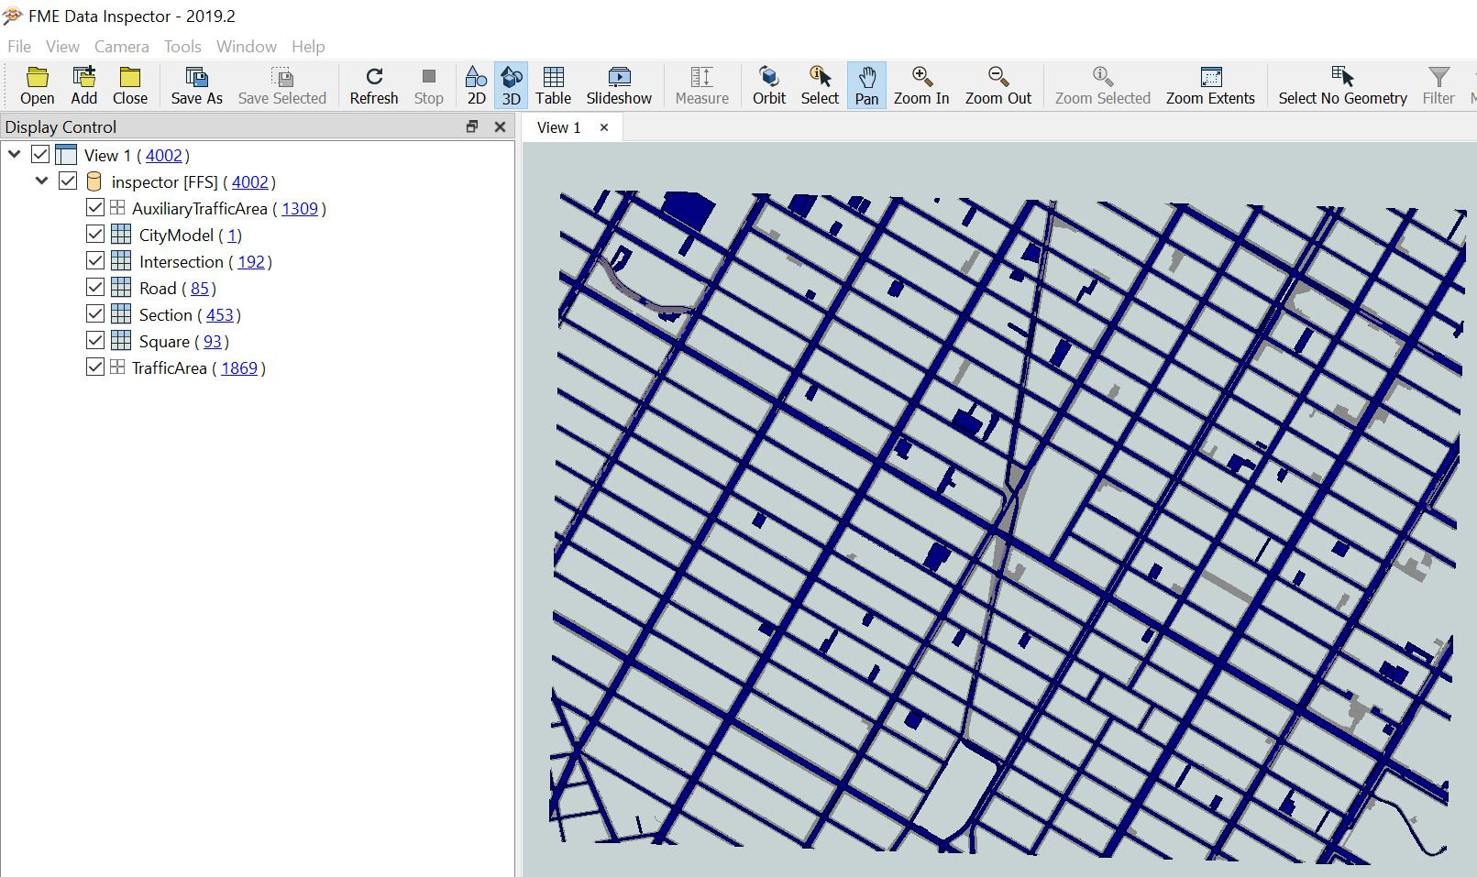
CityGML3.0 Transportation (sample) Dataset
Sample CityGML3.0 dataset generated using FME
FME Writer format: GML
→ Define CityGML3.0 Application Schema
→ Use CityGML3.0 feature types
Using CityGML2.0 Streetspace Model of NYC (2km x 1.5km)
B
first
Result

Slide 2
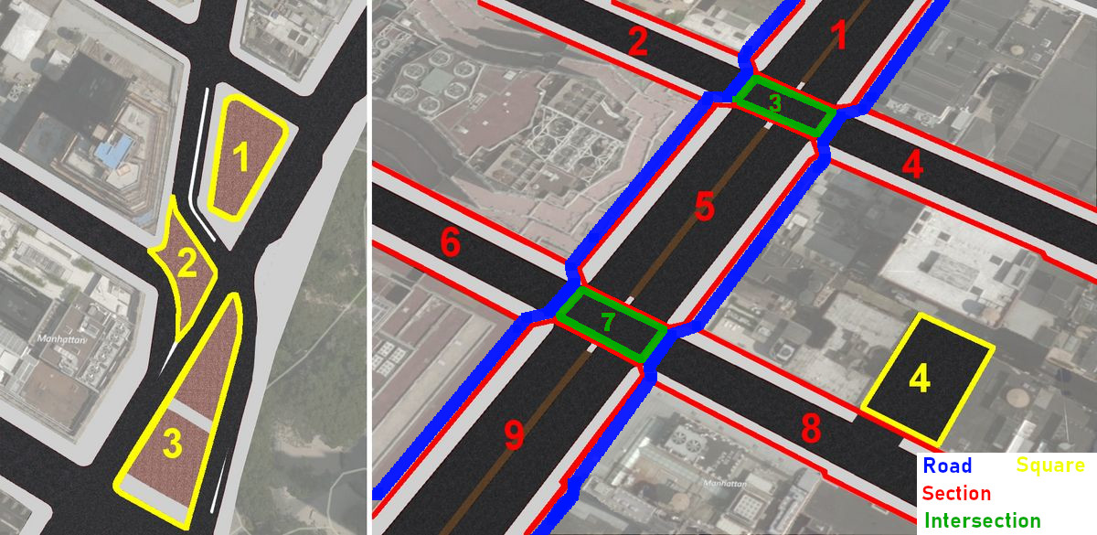
CityGML3.0 Transportation (sample) Dataset
Data structure according to proposed CityGML3.0 Transportation Model
Intersections defined as seen below
A Road (blue) consists of Sections(red) and Intersections (green)
Squares defined as Parking Lots and public Plazas (yellow)
(Auxilliary)TrafficAreas part of Sections / Intersections or Squares

Slide 3
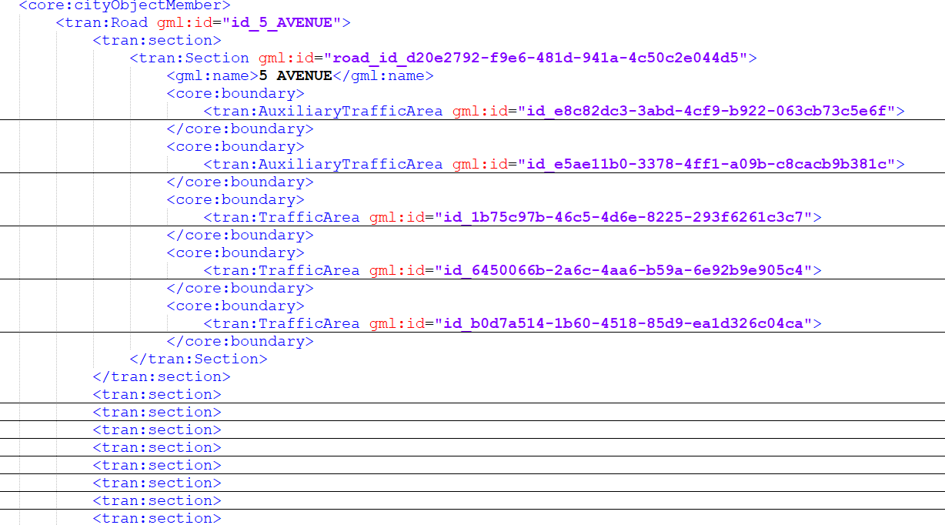
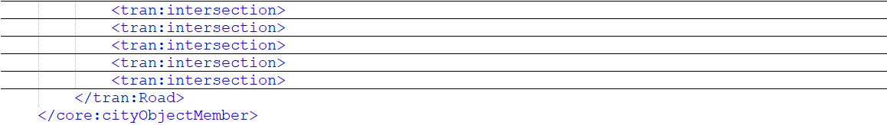
CityGML3.0 Transportation (sample) Dataset
Semantic structure: Road > Section / Intersection > (Auxilliary)TrafficArea

Slide 4
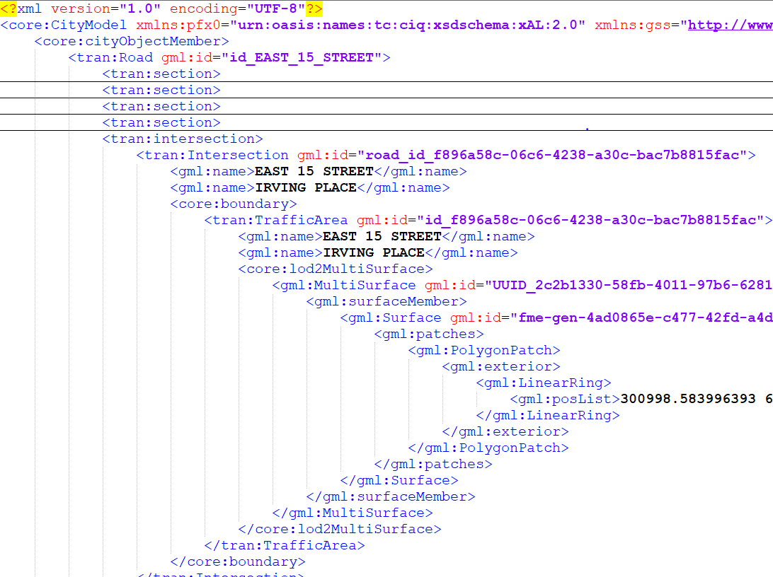
CityGML3.0 Transportation (sample) Dataset
Multiple gml:name attributes for Intersections and
TrafficAreas part of Intersections

Slide 5
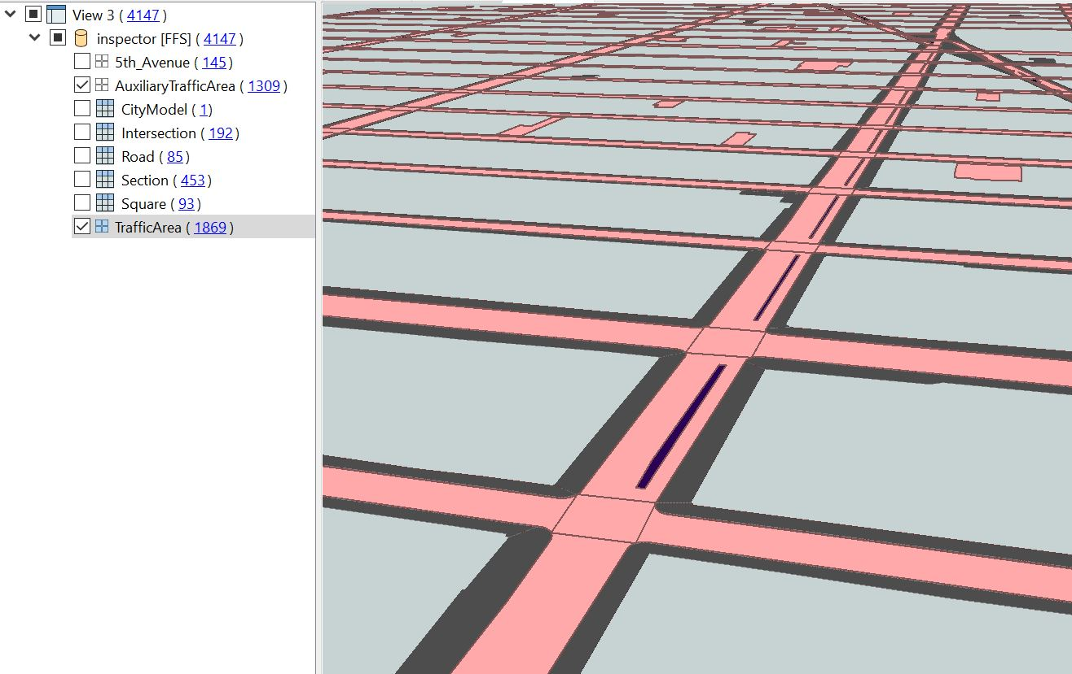
CityGML3.0 Transportation (sample) Dataset
Squares:
Parking Lots
Public Plazas

Slide 6
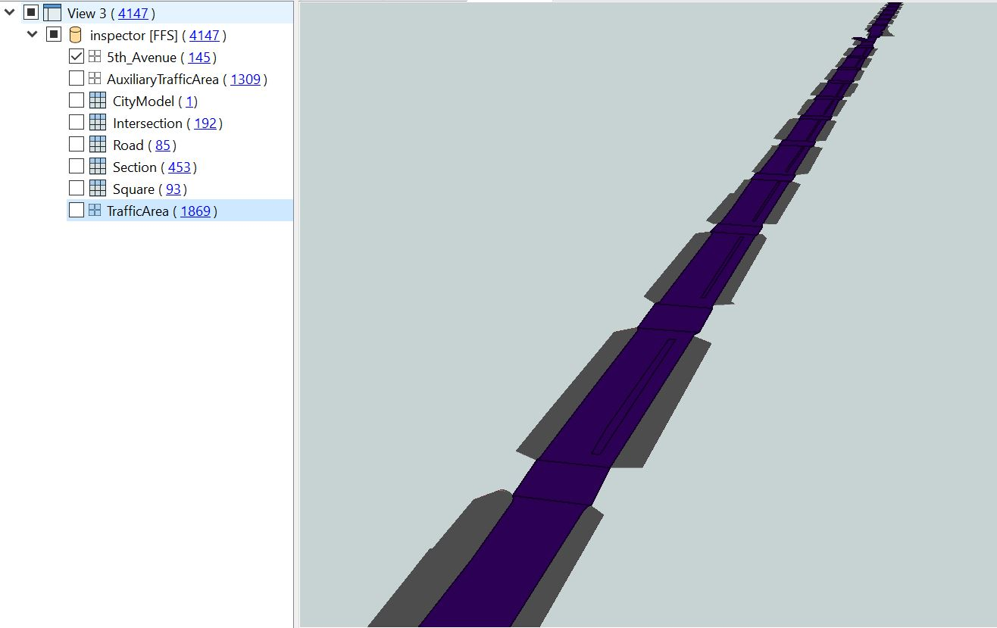
CityGML3.0 Transportation (sample) Dataset
Selection:
(Auxilliary)TrafficAreas with gml:name = 5 AVENUE
→ All (Auxilliary)TrafficAreas that are part of
Sections that are part of Road = 5 AVENUE
XLinks concept not yet implemented

